Slide 1
The Neural Basis of Preferences Construction and Modification: Novel findings from cue-approach paradigm
07/06/2015
Tom Salomon
Dr. Tom Schonberg’s Lab

Slide 2

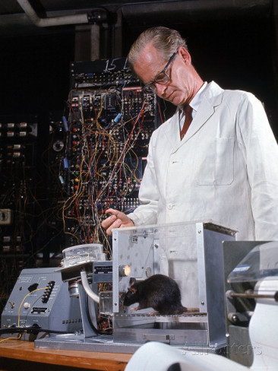
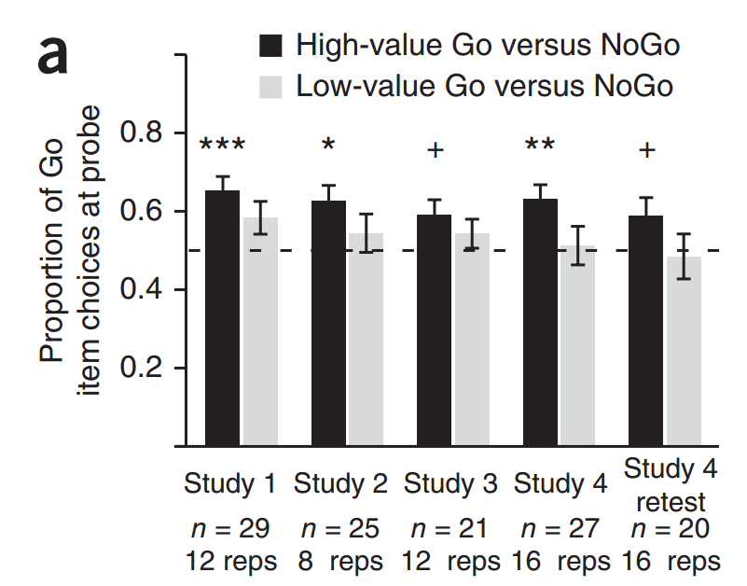
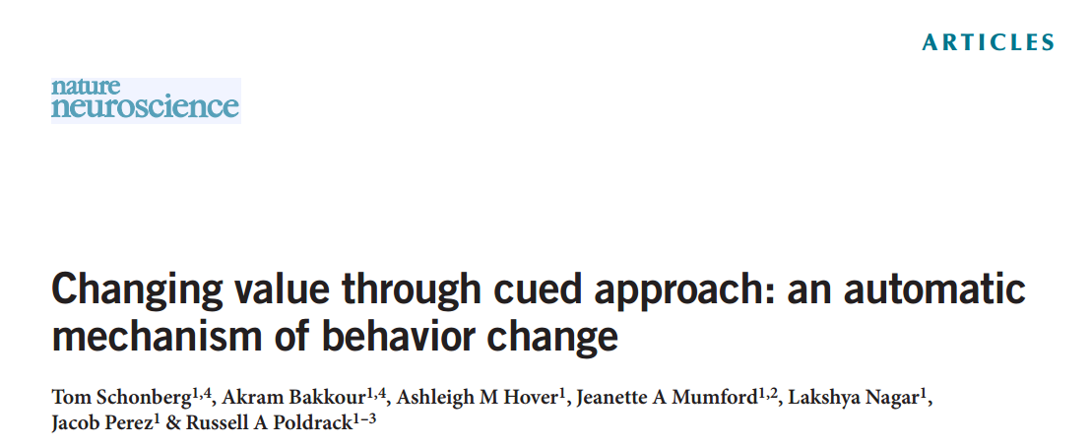
About our lab
Modifying human behavior and preferences via cue-approach task.
Subtle modification procedure
No external reinforcements
Durable, long-lasting effect

Slide 3



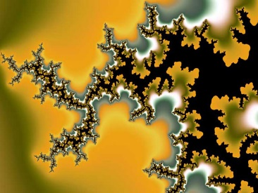
My Project
Extending findings with the cue-approach task to novel untested stimuli:

Slide 4
Why faces?
Facial perception plays an integral part of social interaction. It is one of the most significant cues human beings interact with (Fiske and Taylor, 2013).
Research suggest facial perception and interpretation plays a role in clinical disorders such as depression and anxiety.
Notes:
. People are accustomed to faces from pictures i.e. social networks, dating websites etc. (Cao et al, 2014).

Slide 5
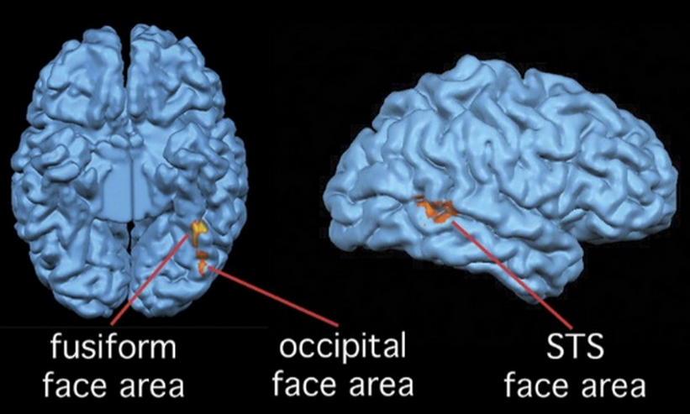
Why faces?
Face perception has specialized brain areas such as the fusiform face area (Kanwisher et al., 1997) which may serve as an interesting regions of interest in neural plasticity study.
(Downing, 2007)
Notes:
. People are accustomed to faces from pictures i.e. social networks, dating websites etc. (Cao et al, 2014).

Slide 6
Experimental Procedure
Ranking
Training
Probe
Recognition

Slide 7
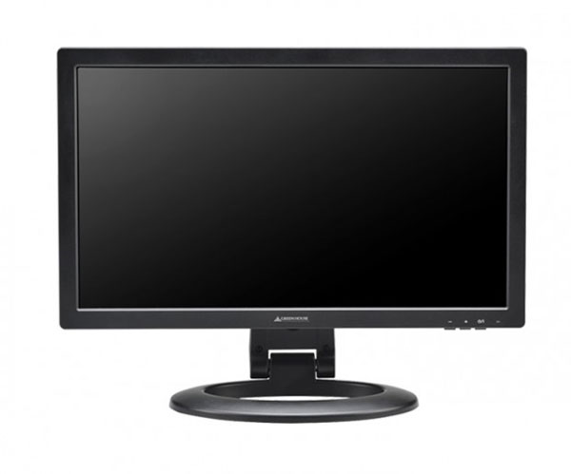

Experimental Procedure
Ranking
Training
Probe
Recognition
+
1 NIS 3NIS 7NIS 10NIS

Slide 8
Experimental Procedure
Binary ranking (Colley’s ranking)
Training
Probe
Recognition
+
300 trials X
60 stimuli
10 presentations per stimulus

Slide 9



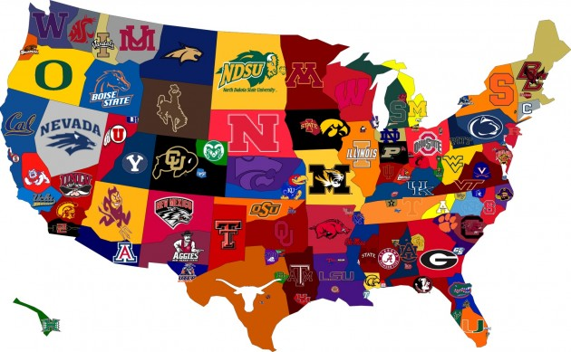

Experimental Procedure
Binary ranking (Colley’s ranking)
Training
Probe
Recognition

Slide 10
Experimental Procedure
Binary ranking (Colley’s ranking)
Training
Probe
Recognition

Slide 11
Experimental Procedure
Binary ranking (Colley’s ranking)
Training
Probe
Recognition
0.708
0.542
0.458
0.292

Slide 12
Experimental Procedure
Binary ranking (Colley’s ranking)
Training
Probe
Recognition
0.708
0.542
0.458
0.292

Slide 13
Experimental Procedure
Binary ranking (Colley’s ranking)
Training
Probe
Recognition
Subject #5
Spearman’s correlation
Faces: ρ = 0.79
Snacks: ρ = 0.89

Slide 14
Experimental Procedure
Binary ranking (Colley’s ranking)
Training
Probe
Recognition
Subject #5
Spearman’s correlation
Faces: ρ = 0.79
Snacks: ρ = 0.89

Slide 15


Experimental Procedure
Binary ranking (Colley’s ranking)
Training
Probe
Recognition
+
12 repetitions X

Slide 16
Experimental Procedure
Binary ranking (Colley’s ranking)
Training
Probe
Recognition
+
2 repetitions X

Slide 17
Probe Comparisons
Highest Values
High Values
High-Sanity
29 | 27 | 25 | 23 | 21 | 19 | 17 | 15 | 13 | 11 | 9 | 7 | 5 | 3 | 1
30 | 28 | 26 | 24 | 22 | 20 | 18 | 16 | 14 | 12 | 10 | 8 | 6 | 4 | 2
31 | 33 | 35 | 37 | 39 | 41 | 43 | 45 | 47 | 49 | 51 | 53 | 55 | 57 | 59
32 | 34 | 36 | 38 | 40 | 42 | 44 | 46 | 48 | 50 | 52 | 54 | 56 | 58 | 60
Lowest Values
Low Values
Low-Sanity

Slide 18
Probe Comparisons
Highest Values
High-High
Middle-High
High-Sanity
29 | 27 | 25 | 23 | 21 | 19 | 17 | 15 | 13 | 11 | 9 | 7 | 5 | 3 | 1
30 | 28 | 26 | 24 | 22 | 20 | 18 | 16 | 14 | 12 | 10 | 8 | 6 | 4 | 2
31 | 33 | 35 | 37 | 39 | 41 | 43 | 45 | 47 | 49 | 51 | 53 | 55 | 57 | 59
32 | 34 | 36 | 38 | 40 | 42 | 44 | 46 | 48 | 50 | 52 | 54 | 56 | 58 | 60
Lowest Values
Low-Low
Middle-Low
Low-Sanity

Slide 19
Experimental Procedure
Binary ranking (Colley’s ranking)
Training
Probe
Recognition
Old/New
Beep/No Beep
+
Included not Included

Slide 20
Experimental Procedure
Binary ranking (Colley’s ranking)
Training
Probe
Recognition
Old/New
Beep/No Beep
40 Old stimuli X
20 new stimuli
Included not Included

Slide 21
Experimental Procedure
Binary ranking (Colley’s ranking)
Training
Probe
Recognition
Old/New
Beep/No Beep
+
Beep no Beep

Slide 22
Experimental Procedure
Binary ranking (Colley’s ranking)
Training
Probe
Recognition
Old/New
Beep/No Beep
Number of stimuli recognized as old X
Beep no Beep

Slide 23
Behavioral Results

Slide 24
Sanity Check
***
**
n=28
* p < 0.05
** p < 0.01
*** p < 0.001

Slide 25
Middle and Extreme Values
**
*
n=28
* p < 0.05
** p < 0.01
*** p < 0.001
Notes:
P=0.003, HH; p=0.03, LL

Slide 26
Middle and Extreme Values
**
*
n=28
* p < 0.05
** p < 0.01
*** p < 0.001
Notes:
P=0.003, HH; p=0.03, LL

Slide 27
Converging vs. Diverging Effects
***
***
n=28
* p < 0.05
** p < 0.01
*** p < 0.001

Slide 28
Converging vs. Diverging Effects
***
***
**
n=28
* p < 0.05
** p < 0.01
*** p < 0.001

Slide 29
Results overview
*
n=28
* p < 0.05
** p < 0.01
*** p < 0.001

Slide 30
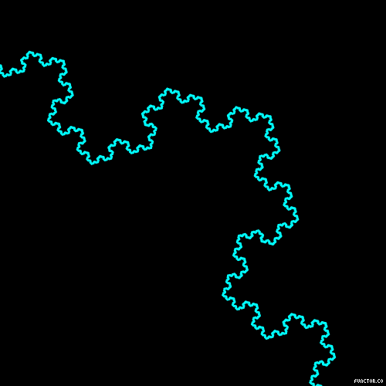
Fractals Experiments Results

Slide 31
Fractals Experiments Results
***
*
n=25
* p < 0.05
** p < 0.01
*** p < 0.001

Slide 32
Middle and Extreme Values
**
**
**
*
n=25
* p < 0.05
** p < 0.01
*** p < 0.001
Notes:
P=0.002, HH; p=0.03, LL

Slide 33
Converging vs. Diverging Effects: Fractals
***
***
n=25
* p < 0.05
** p < 0.01
*** p < 0.001

Slide 34
Converging vs. Diverging Effects: Fractals
***
***
n=25
* p < 0.05
** p < 0.01
*** p < 0.001

Slide 35
Preference and memory
Go Chosen Proportion
High Value Items
Low Value items
Remembered item was Go

Slide 36
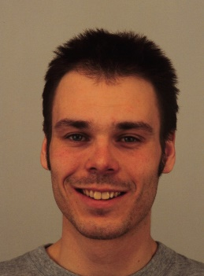
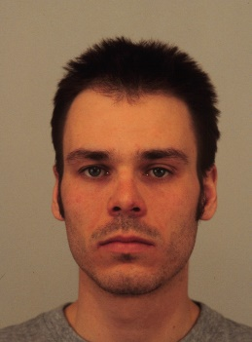

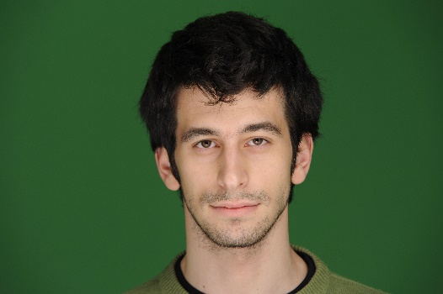
Future Plans
New face stimuli
Emotions?
Imaging experiment: Functional and diffusion imaging

Slide 37
Thanks for Listening!

Slide 38
Reference
Cao, C., Kwak, I. S., Belongie, S., Kriegman, D., Ai1, H. (2014). Adaptive ranking of facial attractiveness. Multimedia and Expo IEEE. 1 – 6.
Fiske S.T. and Taylor, S. E. (2013). Social cognition from brain to culture. Sage: London.
Haxby, J. V., Hoffman,, E.A. and Gobbini , M.I. (2002). Human Neural Systems for Face Recognition and Social Communication. Society of Biological Psychiatry. 51, 11. 59–67.

